Slide 1
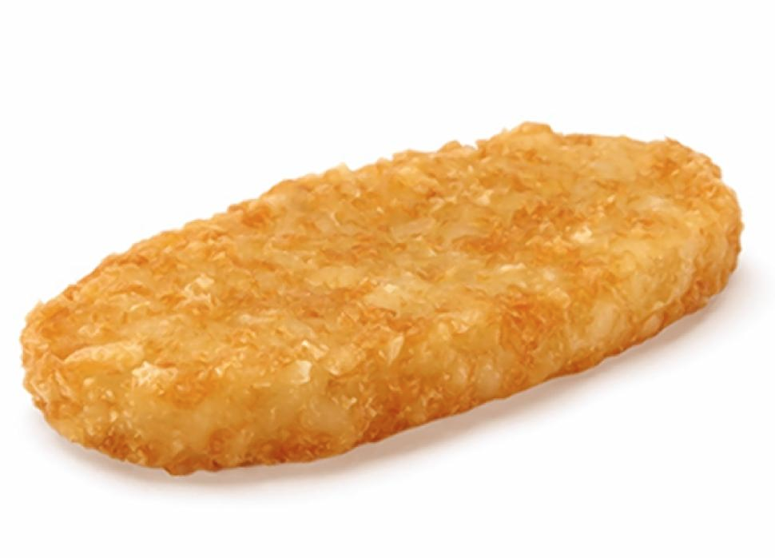
CS61B, 2021
Lecture 19: Hashing
Set Implementations, DataIndexedIntegerSet
Integer Representations of Strings, Integer Overflow
Hash Tables and Handling Collisions
Hash Table Performance and Resizing
Hash Tables in Java

Slide 2
Data Indexed Arrays

Slide 3
Sets
We’ve now seen several implementations of the Set (or Map) ADT.
Set
Map
ArraySet
BST
2-3 Tree
LLRB
Worst case runtimes
 | contains(x) | add(x) | Notes
ArraySet | Θ(N) | Θ(N)
BST | Θ(N) | Θ(N) | Random trees are Θ(log N).
2-3 Tree | Θ(log N) | Θ(log N) | Beautiful idea. Very hard to implement.
LLRB | Θ(log N) | Θ(log N) | Maintains bijection with 2-3 tree. Hard to implement.

Slide 4
Limits of Search Tree Based Sets
Our search tree based sets require items to be comparable.
Need to be able to ask “is X < Y?” Not true of all types.
Could we somehow avoid the need for objects to be comparable?
Our search tree sets have excellent performance, but could maybe be better?
Θ(log N) is amazing. 1 billion items is still only height ~30.
Could we somehow do better than Θ(log N)?
Today we’ll see the answer to both of the questions above is yes.

Slide 5
Using Data as an Index
One extreme approach: Create an array of booleans indexed by data!
Initially all values are false.
When an item is added, set appropriate index to true.
F
0
1
2
3
4
5
6
7
8
9
10
11
12
13
14
15
F
F
F
F
F
F
F
F
DataIndexedIntegerSet diis;
diis = new DataIndexedIntegerSet();
diis.add(0);
F
F
F
F
F
Set containing nothing
F
F
...

Slide 6
Using Data as an Index
One extreme approach: Create an array of booleans indexed by data!
Initially all values are false.
When an item is added, set appropriate index to true.
T
0
1
2
3
4
5
6
7
8
9
10
11
12
13
14
15
F
F
F
F
F
F
F
F
DataIndexedIntegerSet diis;
diis = new DataIndexedIntegerSet();
diis.add(0);
F
F
F
F
F
Set containing 0
F
F
...

Slide 7
Using Data as an Index
One extreme approach: Create an array of booleans indexed by data!
Initially all values are false.
When an item is added, set appropriate index to true.
T
0
1
2
3
4
5
6
7
8
9
10
11
12
13
14
15
F
F
F
F
T
F
F
F
DataIndexedIntegerSet diis;
diis = new DataIndexedIntegerSet();
diis.add(0);
diis.add(5);
F
F
F
F
F
Set containing 0, 5
F
F
...

Slide 8
Using Data as an Index
One extreme approach: Create an array of booleans indexed by data!
Initially all values are false.
When an item is added, set appropriate index to true.
T
0
1
2
3
4
5
6
7
8
9
10
11
12
13
14
15
F
F
F
F
T
F
F
F
DataIndexedIntegerSet diis;
diis = new DataIndexedIntegerSet();
diis.add(0);
diis.add(5);
diis.add(10);
F
T
F
F
F
Set containing 0, 5, 10
F
F
...

Slide 9
Using Data as an Index
One extreme approach: Create an array of booleans indexed by data!
Initially all values are false.
When an item is added, set appropriate index to true.
T
0
1
2
3
4
5
6
7
8
9
10
11
12
13
14
15
F
F
F
F
T
F
F
F
DataIndexedIntegerSet diis;
diis = new DataIndexedIntegerSet();
diis.add(0);
diis.add(5);
diis.add(10);
diis.add(11);
F
T
T
F
F
Set containing 0, 5, 10, 11
F
F
...

Slide 10
DataIndexedIntegerSet Implementation
public class DataIndexedIntegerSet {
private boolean[] present;
public DataIndexedIntegerSet() {
present = new boolean[2000000000];
}
public void add(int i) {
present[i] = true;
}
public boolean contains(int i) {
return present[i];
}
}
T
0
1
2
3
4
5
6
7
8
9
10
11
12
13
14
15
F
F
F
F
T
F
F
F
F
T
T
F
F
F
F
...
Set containing 0, 5, 10, 11

Slide 11
DataIndexedIntegerSet Implementation
public class DataIndexedIntegerSet {
private boolean[] present;
public DataIndexedIntegerSet() {
present = new boolean[2000000000];
}
public void add(int i) {
present[i] = true;
}
public boolean contains(int i) {
return present[i];
}
}
 | contains(x) | add(x)
ArraySet | Θ(N) | Θ(N)
BST | Θ(N) | Θ(N)
2-3 Tree | Θ(log N) | Θ(log N)
LLRB | Θ(log N) | Θ(log N)
DataIndexedArray | Θ(1) | Θ(1)

Slide 12
Using Data as an Index
One extreme approach: Create an array of booleans indexed by data!
Initially all values are false.
When an item is added, set appropriate index to true.
T
0
1
2
3
4
5
6
7
8
9
10
11
12
13
14
15
F
F
F
Downsides of this approach (that we will try to address):
Extremely wasteful of memory. To support checking presence of all positive integers, we need > 2 billion booleans.
Need some way to generalize beyond integers.
F
T
F
F
F
F
DataIndexedIntegerSet diis;
diis = new DataIndexedIntegerSet();
diis.add(0);
diis.add(5);
diis.add(10);
diis.add(11);
T
T
F
F
Set containing 0, 5, 10, 11
F
F
...

Slide 13
DataIndexedEnglishWordSet

Slide 14
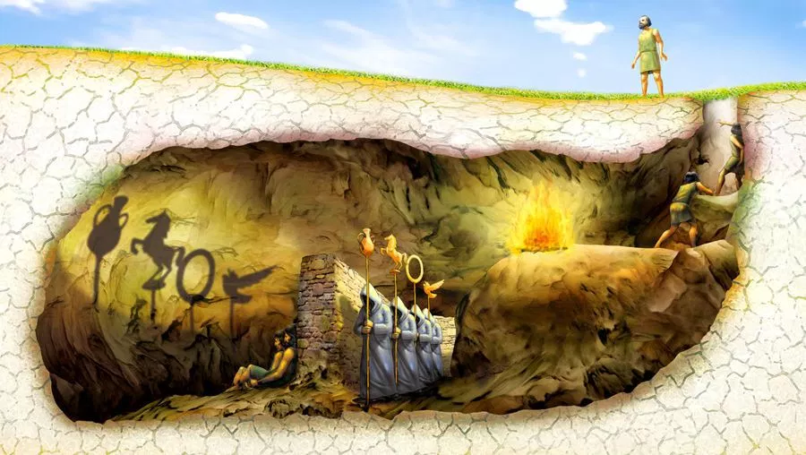
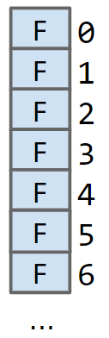
Generalizing the DataIndexedIntegerSet Idea
Ideally, we want a data indexed set that can store arbitrary types.
But previous idea only supports integers!
Let’s talk about storing Strings.
Will get to generic types later.
F
0
1
2
3
4
5
6
F
DataIndexedSet<String> dis =
new DataIndexedSet<>();
dis.add("cat");
dis.add("bee");
dis.add("dog");
F
Where do cat, bee, and dog go???
F
F
F
F
F
...
bee
???
cat
dog

Slide 15
Generalizing the DataIndexedIntegerSet Idea
Suppose we want to add(“cat”)
The key question:
What is the catth element of a list?
One idea: Use the first letter of the word as an index.
a = 1, b = 2, c = 3, …, z = 26
What’s wrong with this approach?
Other words start with c.
contains(“chupacabra”) : true
Can’t store “=98yae98fwyawef”
0
1
2
3
4
25
26
F
a
b
c
d
y
z
F
F
T
F
...
F
F
“chupacabra” collides with “cat”

Slide 16
Avoiding Collisions
Use all digits by multiplying each by a power of 27.
a = 1, b = 2, c = 3, …, z = 26
Thus the index of “cat” is (3 x 27²) + (1 x 27¹) + (20 x 27⁰) = 2234.
Why this specific pattern?
Let’s review how numbers are represented in decimal.
0
1
2
3
4
25
26
2233
2234
2235
F
a
b
c
d
y
z
cas
cat
cau
F
F
F
F
...
F
F
...
F
T
F
...

Slide 17
The Decimal Number System vs. Our System for Strings
In the decimal number system, we have 10 digits: 0, 1, 2, 3, 4, 5, 6, 7, 8, 9
Want numbers larger than 9? Use a sequence of digits.
Example: 7091 in base 10
7091₁₀ = (7 x 10³) + (0 x 10²) + (9 x 10¹) + (1 x 10⁰)
Our system for strings is almost the same, but with letters.

Slide 18
Test Your Understanding
Convert the word “bee” into a number by using our “powers of 27” strategy.
Reminder: cat₂₇ = (3 x 27²) + (1 x 27¹) + (20 x 27⁰) = 2234₁₀
Hint: ‘b’ is letter 2, and ‘e’ is letter 5.

Slide 19
Test Your Understanding
Convert the word “bee” into a number by using our “powers of 27” strategy.
Reminder: cat₂₇ = (3 x 27²) + (1 x 27¹) + (20 x 27⁰) = 2234₁₀
Hint: ‘b’ is letter 2, and ‘e’ is letter 5.
bee₂₇ = (2 x 27²) + (5 x 27¹) + (5 x 27⁰) = 1598₁₀

Slide 20
Uniqueness
cat₂₇ = (3 x 27²) + (1 x 27¹) + (20 x 27⁰) = 2234₁₀
bee₂₇ = (2 x 27²) + (5 x 27¹) + (5 x 27⁰) = 1598₁₀
As long as we pick a base ≥ 26, this algorithm is guaranteed to give each lowercase English word a unique number!
Using base 27, no other words will get the number 1598.
In other words: Guaranteed that we will never have a collision.

Slide 21
Implementing englishToInt (optional)
Optional exercise: Try to write a function englishToInt that can convert English strings to integers by adding characters scaled by powers of 27.
Examples:
a: 1
z: 26
aa: 28
bee: 1598
cat: 2234
dog: 3328
potato: 237,949,071

Slide 22
Implementing englishToInt (optional) (solution)
/** Converts ith character of String to a letter number. * e.g. 'a' -> 1, 'b' -> 2, 'z' -> 26 */
public static int letterNum(String s, int i) {
int ithChar = s.charAt(i);
if ((ithChar < 'a') || (ithChar > 'z'))
{ throw new IllegalArgumentException(); }
return ithChar - 'a' + 1;
}
public static int englishToInt(String s) {
int intRep = 0;
for (int i = 0; i < s.length(); i += 1) {
intRep = intRep * 27;
intRep = intRep + letterNum(s, i);
}
return intRep;
}

Slide 23
DataIndexedEnglishWordSet Implementation
public class DataIndexedEnglishWordSet {
private boolean[] present;
public DataIndexedEnglishWordSet() {
present = new boolean[2000000000];
}
public void add(String s) {
present[englishToInt(s)] = true;
}
public boolean contains(int i) {
return present[englishToInt(s)];
}
}
0
1
2
3
4
25
26
2233
2234
2235
F
a
b
c
d
y
z
cas
cat
cau
F
F
F
F
...
F
F
...
F
T
F
...
Set containing “cat”

Slide 24
DataIndexedStringSet

Slide 25
DataIndexedStringSet
Using only lowercase English characters is too restrictive.
What if we want to store strings like “2pac” or “eGg!”?
To understand what value we need to use for our base, let’s discuss briefly discuss the ASCII standard.

Slide 26
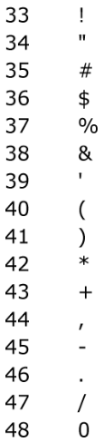
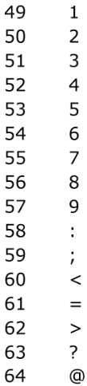
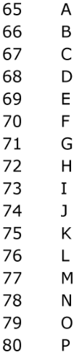
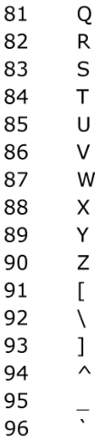
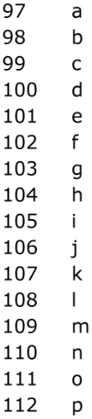
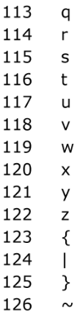
ASCII Characters
The most basic character set used by most computers is ASCII format.
Each possible character is assigned a value between 0 and 127.
Characters 33 - 126 are “printable”, and are shown below.
For example, char c = ’D’ is equivalent to char c = 68.
biggest value is 126

Slide 27
DataIndexedStringSet
Using only lowercase English characters is too restrictive.
What if we want to store strings like “2pac” or “eGg!”?
Maximum possible value for english-only text including punctuation is 126, so let’s use 126 as our base in order to ensure unique values for all possible strings.
Examples:
bee₁₂₆= (98 x 126²) + (101 x 126¹) + (101 x 126⁰) = 1,568,675
2pac₁₂₆= (50 x 126³) + (112 x 126²) + (97 x 126¹) + (99 x 126⁰) = 101,809,233
eGg!₁₂₆= (98 x 126³) + (71 x 126²) + (98 x 126¹) + (33 x 126⁰) = 203,178,213

Slide 28
Implementing asciiToInt
The corresponding integer conversion function is actually even simpler than englishToInt! Using the raw character value means we avoid the need for a helper method.
What if we want to use characters beyond ASCII?
public static int asciiToInt(String s) {
int intRep = 0;
for (int i = 0; i < s.length(); i += 1) {
intRep = intRep * 126;
intRep = intRep + s.charAt(i);
}
return intRep;
}

Slide 29
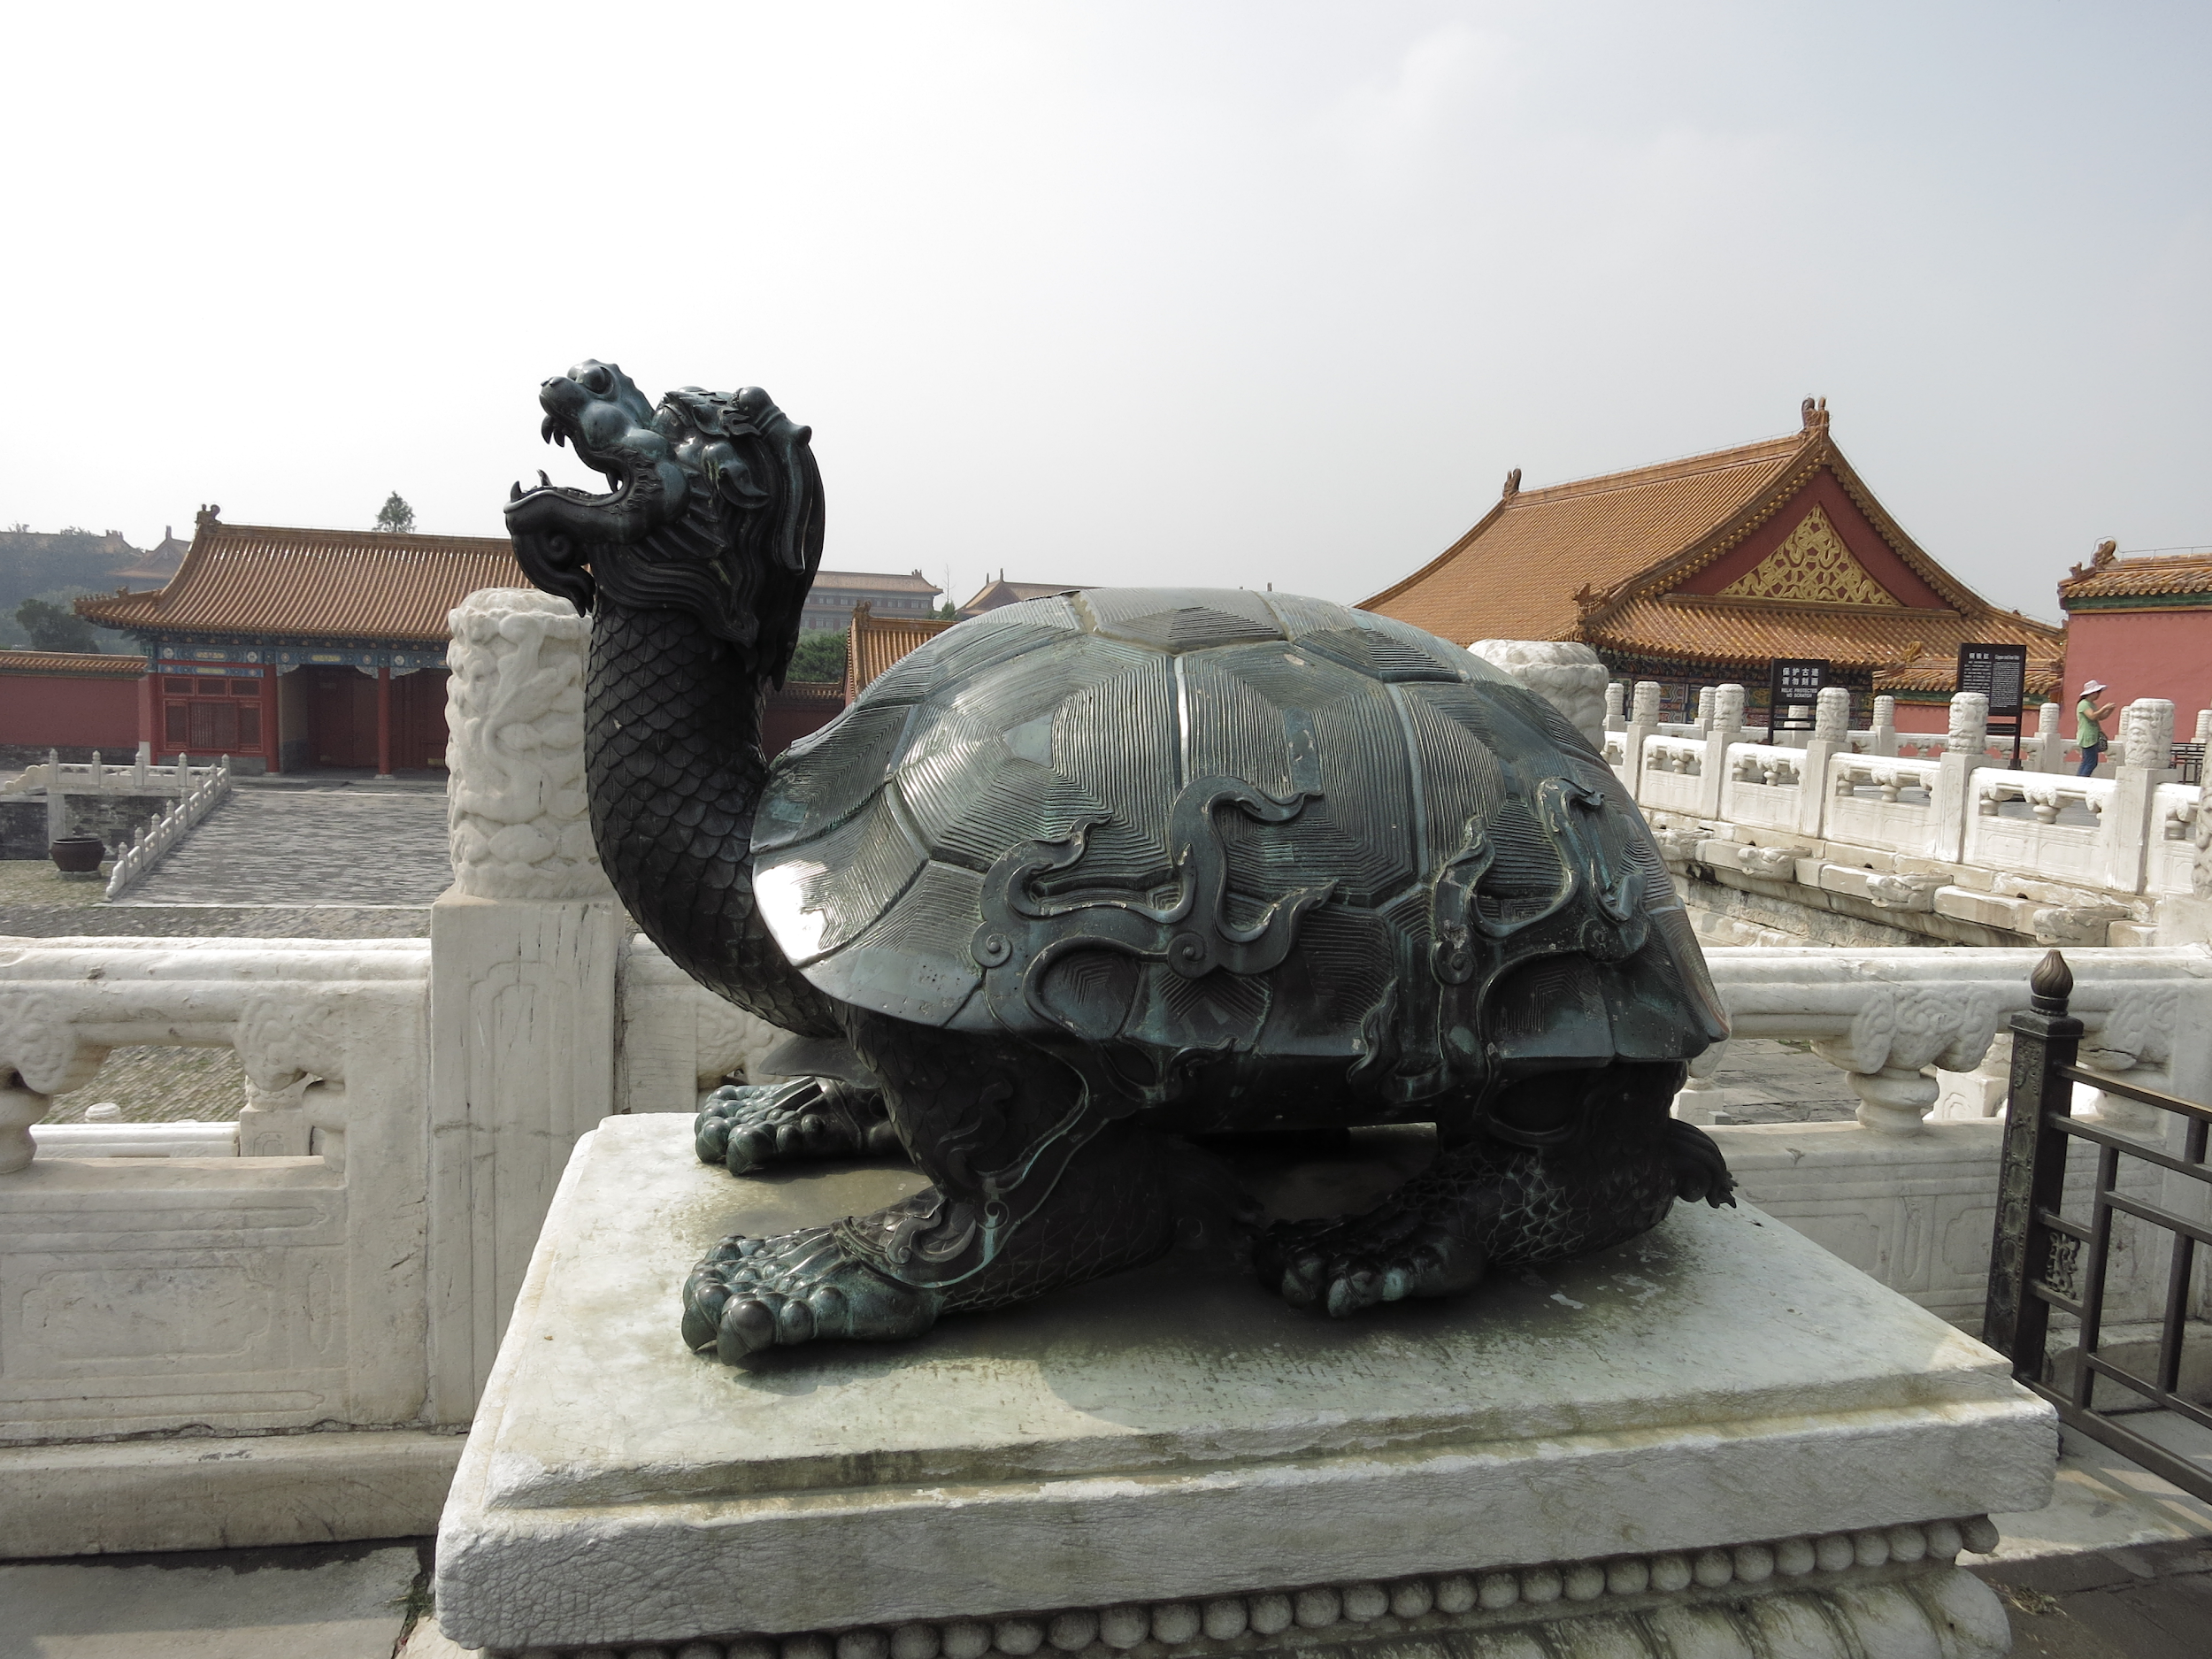
Going Beyond ASCII
chars in Java also support character sets for other languages and symbols.
char c = ’☂’ is equivalent to char c = 9730.
char c = ’鳌’ is equivalent to char c = 40140.
char c = ’혜’ is equivalent to char c = 54812.
This encoding is known as Unicode. Table is too big to list.

Slide 30

Example: Computing Unique Representations of Chinese
The largest possible value for Chinese characters is 40,959*, so we’d need to use this as our base if we want to have a unique representation for all possible strings of Chinese characters.
Example:
守门员₄₀₉₅₉ = (23432 x 40959²) + (38376 x 40959¹) + (21592 x 40959⁰) = 39,312,024,869,368
...
39,3120,2486,9367
39,3120,2486,9368
39,3120,2486,9369
F
守门呗
守门员
守门呙
T
*If you’re curious, the last character is:
F
...

Slide 31
Integer Overflow and Hash Codes

Slide 32
Major Problem: Integer Overflow
In Java, the largest possible integer is 2,147,483,647.
If you go over this limit, you overflow, starting back over at the smallest integer, which is -2,147,483,648.
In other words, the next number after 2,147,483,647 is -2,147,483,648.
int x = 2147483647;
System.out.println(x);
System.out.println(x + 1);
jug ~/Dropbox/61b/lec/hashing
$ javac BiggestPlusOne.java
$ java BiggestPlusOne
2147483647
-2147483648

Slide 33
Consequence of Overflow: Collisions
Because Java has a maximum integer, we won’t get the numbers we expect!
With base 126, we will run into overflow even for short strings.
Example: omens₁₂₆= 28,196,917,171, which is much greater than the maximum integer!
asciiToInt(’omens’) will give us -1,867,853,901 instead.

Slide 34
Consequence of Overflow: Collisions
Because Java has a maximum integer, we won’t get the numbers we expect!
With base 126, we will run into overflow even for short strings.
Example: omens₁₂₆= 28,196,917,171, which is much greater than the maximum integer!
asciiToInt(’omens’) will give us -1,867,853,901 instead.
Overflow can result in collisions, causing incorrect answers.
public void moo() {
DataIndexedStringSet disi = new DataIndexedStringSet();
disi.add("melt banana");
disi.contains("subterrestrial anticosmetic");
//asciiToInt for these strings is 839099497
}
returns true!

Slide 35
Hash Codes and the Pigeonhole Principle
The official term for the number we’re computing is “hash code”.
Via Wolfram Alpha: a hash code “projects a value from a set with many (or even an infinite number of) members to a value from a set with a fixed number of (fewer) members.”
Here, our target set is the set of Java integers, which is of size 4294967296.

Slide 36
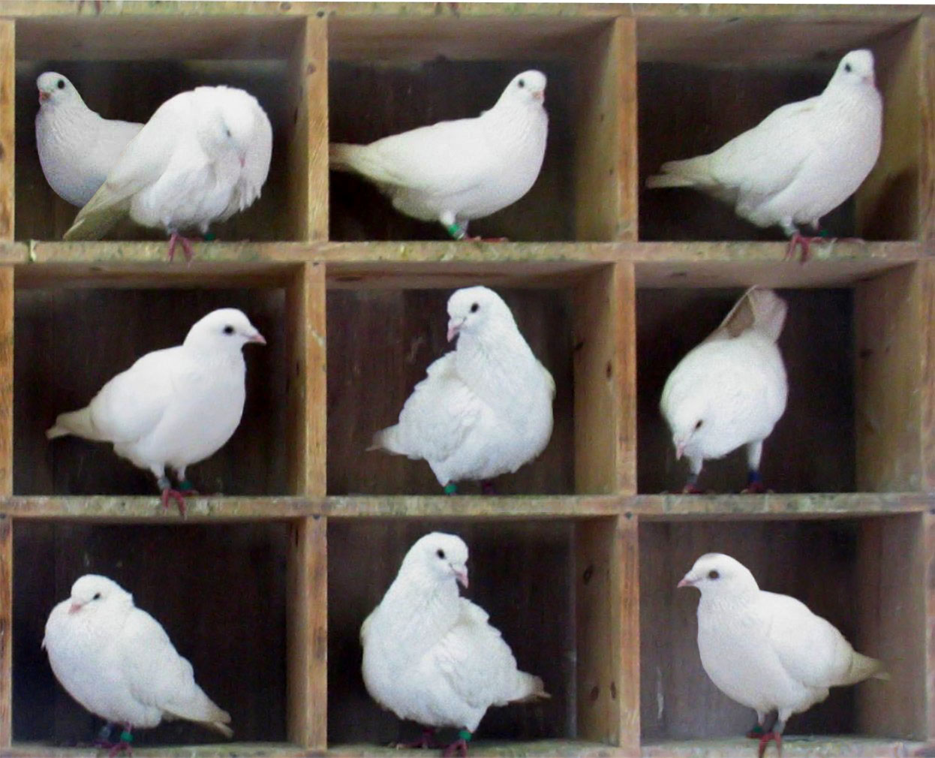
Hash Codes and the Pigeonhole Principle
The official term for the number we’re computing is “hash code”.
Via Wolfram Alpha: a hash code “projects a value from a set with many (or even an infinite number of) members to a value from a set with a fixed number of (fewer) members.”
Here, our target set is the set of Java integers, which is of size 4294967296.
Pigeonhole principle tells us that if there are more than 4294967296 possible items, multiple items will share the same hash code.
There are more than 4294967296 planets.
Each has mass, xPos, yPos, xVel, yVel, imgName.
There are more than 4294967296 strings.
“one”, “two”, … “nineteen quadrillion”, ...
Bottom line: Collisions are inevitable.

Slide 37
Two Fundamental Challenges
Two fundamental challenges:
How do we resolve hashCode collisions (“melt banana” vs. “subterrestrial anticosmetic”)?
We’ll call this collision handling.
How do we compute a hash code for arbitrary objects?
We’ll call this computing a hashCode.
Example: Our hashCode for “melt banana” was 839099497.
For Strings, this was relatively straightforward (treat as a base 27 or base 126 or base 40959 number).

Slide 38
Hash Tables:
Handling Collisions

Slide 39
Resolving Ambiguity
Pigeonhole principle tells us that collisions are inevitable due to integer overflow.
Example: hash code for “moo” and “Ñep” might both be 718.
Suppose N items have the same numerical representation h:
Instead of storing true in position h, store a “bucket” of these N items at position h.
How to implement a “bucket”?
Conceptually simplest way: LinkedList.
Could also use ArrayLists.
Could also use an ArraySet.
Will see it doesn’t really matter what you do.
0
717
718
719
F
0
717
718
719
...
...
moo
F
T
Ñep
F
...
...

Slide 40
The Separate Chaining Data Indexed Array
Each bucket in our array is initially empty. When an item x gets added at index h:
If bucket h is empty, we create a new list containing x and store it at index h.
If bucket h is already a list, we add x to this list if it is not already present.
We might call this a “separate chaining data indexed array”.
Bucket #h is a “separate chain” of all items that have hash code h.
0
1
...
Initially all buckets are empty.
111239443
111239444
111239445
...

Slide 41
The Separate Chaining Data Indexed Array
Each bucket in our array is initially empty. When an item x gets added at index h:
If bucket h is empty, we create a new list containing x and store it at index h.
If bucket h is already a list, we add x to this list if it is not already present.
We might call this a “separate chaining data indexed array”.
Bucket #h is a “separate chain” of all items that have hash code h.
add(“a”)
0
1
Bucket 1 now has a length 1 list.
a
...
111239443
111239444
111239445
...

Slide 42
The Separate Chaining Data Indexed Array
Each bucket in our array is initially empty. When an item x gets added at index h:
If bucket h is empty, we create a new list containing x and store it at index h.
If bucket h is already a list, we add x to this list if it is not already present.
We might call this a “separate chaining data indexed array”.
Bucket #h is a “separate chain” of all items that have hash code h.
add(“a”)
add(“abomamora”)
0
1
a
...
111239443
111239444
111239445
abomamora
...

Slide 43
The Separate Chaining Data Indexed Array
Each bucket in our array is initially empty. When an item x gets added at index h:
If bucket h is empty, we create a new list containing x and store it at index h.
If bucket h is already a list, we add x to this list if it is not already present.
We might call this a “separate chaining data indexed array”.
Bucket #h is a “separate chain” of all items that have hash code h.
add(“a”)
add(“abomamora”)
add(“adevilish”)
0
1
a
...
111239443
111239444
111239445
abomamora
adevilish
Both have hash code 111239444 using englishToInt
...

Slide 44
The Separate Chaining Data Indexed Array
Each bucket in our array is initially empty. When an item x gets added at index h:
If bucket h is empty, we create a new list containing x and store it at index h.
If bucket h is already a list, we add x to this list if it is not already present.
We might call this a “separate chaining data indexed array”.
Bucket #h is a “separate chain” of all items that have hash code h.
add(“a”)
add(“abomamora”)
add(“adevilish”)
add(“abomamora”)
0
1
a
...
111239443
111239444
111239445
abomamora
adevilish
Both have hash code 111239444 using englishToInt
...

Slide 45
The Separate Chaining Data Indexed Array
Each bucket in our array is initially empty. When an item x gets added at index h:
If bucket h is empty, we create a new list containing x and store it at index h.
If bucket h is already a list, we add x to this list if it is not already present.
We might call this a “separate chaining data indexed array”.
Bucket #h is a “separate chain” of all items that have hash code h.
add(“a”)
add(“abomamora”)
add(“adevilish”)
add(“abomamora”)
contains(“adevilish”)
Look at all items in bucket 111239443 to see if “adevilish” is present.
0
1
a
...
111239443
111239444
111239445
abomamora
adevilish
...

Slide 46
Separate Chaining Performance
Observation: Worst case runtime will be proportional to length of longest list.
0
1598
2234
3328
111239443
111239442
Worst case time | contains(x) | add(x)
Bushy BSTs | Θ(log N) | Θ(log N)
DataIndexedArray | Θ(1) | Θ(1)
Separate Chaining Data Indexed Array | Θ(Q) | Θ(Q)
...
bee
...
cat
Q: Length of longest list
Why Q and not 1?
...
dog
...
abomamora
adevilish

Slide 47
Saving Memory Using Separate Chaining
Observation: We don’t really need billions of buckets.
0
1598
2234
3328
111239443
111239442
Q: If we use the 10 buckets on the right, where should our five items go?
...
0
1
2
3
4
5
6
7
8
9
bee
...
cat
...
dog
...
abomamora
adevilish

Slide 48
Saving Memory Using Separate Chaining and Modulus
Observation: Can use modulus of hashcode to reduce bucket count.
Downside: Lists will be longer.
0
1598
2234
3328
111239443
111239442
Q: If we use the 10 buckets on the right, where should our five items go?
Put in bucket = hashCode % 10
...
0
1
2
3
4
5
6
7
8
9
bee
...
cat
abomamora
adevilish
...
cat
dog
...
bee
dog
abomamora
adevilish

Slide 49
The Hash Table
What we’ve just created here is called a hash table.
Data is converted by a hash function into an integer representation called a hash code.
The hash code is then reduced to a valid index, usually using the modulus operator, e.g. 2348762878 % 10 = 8.
0
1
2
3
4
5
6
7
8
9
hug
抱抱
포옹
data
hash function
hash code
抱抱
unicodeToInt
1034854400
الطبيعة
% 10
0
reduce
index
bee
dog
In Java there’s a caveat here. Will revisit later.
están
शानदार
hash table

Slide 50
Hash Table Performance

Slide 51
Hash Table Runtime
Worst case runtimes
0
1
2
3
4
 | contains(x) | add(x)
Bushy BSTs | Θ(log N) | Θ(log N)
DataIndexedArray | Θ(1) | Θ(1)
Separate Chaining Hash Table | Θ(Q) | Θ(Q)
Q: Length of longest list
The good news: We use way less memory and can now handle arbitrary data.
The bad news: Worst case runtime is now Θ(Q), where Q is the length of the longest list.

Slide 52
Hash Table Runtime: http://yellkey.com/somebody
Worst case runtimes
0
1
2
3
4
 | contains(x) | add(x)
Bushy BSTs | Θ(log N) | Θ(log N)
DataIndexedArray | Θ(1) | Θ(1)
Separate Chaining Hash Table | Θ(Q) | Θ(Q)
For the hash table above with 5 buckets, give the order of growth of Q with respect to N.
Q is Θ(1)
Q is Θ(log N)
Q is Θ(N)
Q is Θ(N log N)
Q is Θ(N²)
Q: Length of longest list

Slide 53
Hash Table Runtime
Worst case runtimes
0
1
2
3
4
 | contains(x) | add(x)
Bushy BSTs | Θ(log N) | Θ(log N)
DataIndexedArray | Θ(1) | Θ(1)
Separate Chaining Hash Table | Θ(Q) | Θ(Q)
For the hash table above with 5 buckets, give the order of growth of Q with respect to N.
C. Q is Θ(N)
Q: Length of longest list
All items evenly distributed.
All items in same list.
In the best case, the length of the longest list will be N/5. In the worst case, it will be N. In both cases, Q(N) is Θ(N).

Slide 54
Improving the Hash Table
Worst case runtimes
0
1
2
3
4
 | contains(x) | add(x)
Bushy BSTs | Θ(log N) | Θ(log N)
DataIndexedArray | Θ(1) | Θ(1)
Separate Chaining Hash Table | Θ(Q) | Θ(Q)
Suppose we have:
A fixed number of buckets M.
An increasing number of items N.
Q: Length of longest list
Major problem: Even if items are spread out evenly, lists are of length Q = N/M.
For M = 5, that means Q = Θ(N). Results in linear time operations.
Hard question: How can we improve our design to guarantee that N/M is Θ(1)?

Slide 55
Hash Table Runtime
Worst case runtimes
0
1
2
3
4
 | contains(x) | add(x)
Bushy BSTs | Θ(log N) | Θ(log N)
DataIndexedArray | Θ(1) | Θ(1)
Separate Chaining Hash Table | Θ(Q) | Θ(Q)
Suppose we have:
An increasing number of buckets M.
An increasing number of items N.
Q: Length of longest list
Major problem: Even if items are spread out evenly, lists are of length Q = N/M.
For M = 5, that means Q = Θ(N). Results in linear time operations.
Hard question: How can we improve our design to guarantee that N/M is Θ(1)?

Slide 56
Hash Table Runtime
Suppose we have:
An increasing number of buckets M.
An increasing number of items N.
As long as M = Θ(N), then O(N/M) = O(1).
0
1
2
3
4
One example strategy: When N/M is ≥ 1.5, then double M.
We often call this process of increasing M “resizing”.
N/M is often called the “load factor”. It represents how full the hash table is.
This rule ensures that the average list is never more than 1.5 items long!

Slide 57
Hash Table Resizing Example
When N/M is ≥ 1.5, then double M.
N = 0 M = 4 N / M = 0
0
1
2
3

Slide 58

Hash Table Resizing Example
When N/M is ≥ 1.5, then double M.
N = 1 M = 4 N / M = 0.25
0
1
2
3
7

Slide 59

Hash Table Resizing Example
When N/M is ≥ 1.5, then double M.
N = 2 M = 4 N / M = 0.5
16
0
1
2
3
7

Slide 60

Hash Table Resizing Example
When N/M is ≥ 1.5, then double M.
N = 3 M = 4 N / M = 0.75
16
0
1
2
3
7
3

Slide 61

Hash Table Resizing Example
When N/M is ≥ 1.5, then double M.
N = 4 M = 4 N / M = 1
16
0
1
2
3
7
3
11

Slide 62

Hash Table Resizing Example
When N/M is ≥ 1.5, then double M.
N = 5 M = 4 N / M = 1.25
16
20
0
1
2
3
7
3
11

Slide 63

Hash Table Resizing Example
When N/M is ≥ 1.5, then double M.
N = 6 M = 4 N / M = 1.5
16
20
N/M is too large. Time to double!
0
1
2
3
13
7
3
11

Slide 64
Hash Table Resizing Example
When N/M is ≥ 1.5, then double M.
Yellkey question: Where will the bucket go?
Or: Draw the results after doubling M.
0
1
2
3
4
5
6
7
?
?
N = 6 M = 4 N / M = 1.5
?
16
20
N/M is too large. Time to double!
?
0
1
2
3
13
?
?
7
3
11
?
?

Slide 65
Hash Table Resizing Example
When N/M is ≥ 1.5, then double M.
Draw the results after doubling M.
N = 6 M = 8 N / M = 0.75
16
0
1
2
3
4
5
6
7
N = 6 M = 4 N / M = 1.5
16
20
3
11
0
1
2
3
N/M is too large. Time to double!
20
13
13
7
3
11
7

Slide 66
Resizing Hash Table Runtime
Suppose we have:
An increasing number of buckets M.
An increasing number of items N.
As long as M = Θ(N), then O(N/M) = O(1).
0
1
2
3
4
N = 19 M = 5 N / M = 3.8
Assuming items are evenly distributed (as above), lists will be approximately N/M items long, resulting in Θ(N/M) runtimes.
Our doubling strategy ensures that N/M = O(1).
Thus, worst case runtime for all operations is Θ(N/M) = Θ(1).
… unless that operation causes a resize.

Slide 67
Resizing Hash Table Runtime
Suppose we have:
An increasing number of buckets M.
An increasing number of items N.
As long as M = Θ(N), then O(N/M) = O(1).
0
1
2
3
4
N = 19 M = 5 N / M = 3.8
One important thing to consider is the cost of the resize operation.
Resizing takes Θ(N) time. Have to redistribute all items!
Most add operations will be Θ(1). Some will be Θ(N) time (to resize).
Similar to our ALists, as long as we resize by a multiplicative factor, the average runtime will still be Θ(1).
Note: We will eventually analyze this in more detail.

Slide 68
Hash Table Runtime
Worst case runtimes
0
1
2
3
4
 | contains(x) | add(x)
Bushy BSTs | Θ(log N) | Θ(log N)
DataIndexedArray | Θ(1) | Θ(1)
Separate Chaining Hash Table With No Resizing | Θ(N) | Θ(N)
… With Resizing | Θ(1)† | Θ(1)*†
Because Q = Θ(N)
Because Q = Θ(1)
Hash table operations are on average constant time if:
We double M to ensure constant average bucket length.
Items are evenly distributed.
*: Indicates “on average”.
†: Assuming items are evenly spread.

Slide 69
Regarding Even Distribution
Even distribution of item is critical for good hash table performance.
Both tables below have load factor of N/M = 1.
Left table is much worse!
Contains is Θ(N) for x.
Will need to discuss how to ensure even distribution.
First, let’s talk a little bit about how hash tables work in Java.
x
x

Slide 70
Hash Tables in Java

Slide 71
The Ubiquity of Hash Tables
Hash tables are the most popular implementation for sets and maps.
Great performance in practice.
Don’t require items to be comparable.
Implementations often relatively simple.
Python dictionaries are just hash tables in disguise.
In Java, implemented as java.util.HashMap and java.util.HashSet.
How does a HashMap know how to compute each object’s hash code?
Good news: It’s not “implements Hashable”.
Instead, all objects in Java must implement a .hashCode() method.

Slide 72
Objects
All classes are hyponyms of Object.
String toString()
boolean equals(Object obj)
Class<?> getClass()
int hashCode()
protected Object clone()
protected void finalize()
void notify()
void notifyAll()
void wait()
void wait(long timeout)
void wait(long timeout, int nanos)
Default implementation simply returns the memory address of the object.

Slide 73
Examples of Real Java HashCodes
We can see that Strings in Java override hashCode, doing something vaguely like what we did earlier.
Will see the actual hashCode() function later!
System.out.println("a".hashCode());
System.out.println("bee".hashCode());
System.out.println("포옹".hashCode());
System.out.println("kamala lifefully".hashCode());
System.out.println("đậu hũ".hashCode());
jug ~/Dropbox/61b/lec/hashing
$ java JavaHashCodeExamples
97
97410
1732557
1732557
-2108180664
"a"
"bee"
"포옹"
"kamala lifefully"
"đậu hũ"

Slide 74
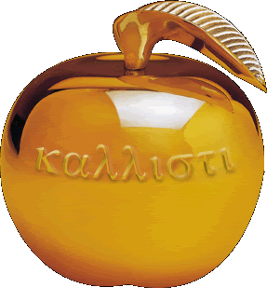
Using Negative hash codes: http://yellkey.com/without
Suppose that ‘s hash code is -1.
Philosophically, into which bucket is it most natural to place this item?
0
1
2
3

Slide 75
Using Negative hash codes: http://yellkey.com/medical
Using Negative hash codes: http://yellkey.com/medical
Suppose that ‘s hash code is -1.
Philosophically, into which bucket is it most natural to place this item?
I say 3, since -1 → 3, 0 → 0, 1 → 1, 2 → 2, 3 → 3, 4 → 0, ...
0
1
2
3
-1

Slide 76
Using Negative hash codes in Java
Suppose that ‘s hash code is -1.
Unfortunately, -1 % 4 = -1. Will result in index errors!
Use Math.floorMod instead.
public class ModTest {
public static void main(String[] args) {
System.out.println(-1 % 4);
System.out.println(Math.floorMod(-1, 4));
}
}
0
1
2
3
$ java ModTest
-1
3

Slide 77
Hash Tables in Java
Java hash tables:
Data is converted by the hashCode method an integer representation called a hash code.
The hash code is then reduced to a valid index, using something like the floorMod function, e.g. Math.floorMod(1732557 % 4) = 8.
0
1
2
3
đậu hũ
data
hash function
hash code
a
포옹
kamala lifefully
bee
đậu hũ
hashCode()
-2108180664
Math.floorMod(x, 4)
0
reduce
index

Slide 78
Hash Tables in Java
Someone asks me (the hash table) for “cow”:
Hashcode of cow % array size: get back 1
!n.key.equals(“cow”) so go to next.
!n.key.equals(“cow”) so go to next.
n.key.equals(“cow”), so: return n.value
Earlier you said the “load factor” was hash code / number of buckets, but it’s number of items / number of buckets.
Load factor: number of items / number of buckets
Bucket number: hash code % number of buckets
0
1
2
3
đậu hũ: 3
a: 5
.key [포옹]
.value [9]
bee: 2
.key [cow]
.value [12]

Slide 79
Two Important Warnings When Using HashMaps/HashSets
Warning #1: Never store objects that can change in a HashSet or HashMap!
If an object’s variables changes, then its hashCode changes. May result in items getting lost.
Warning #2: Never override equals without also overriding hashCode.
Can also lead to items getting lost and generally weird behavior.
HashMaps and HashSets use equals to determine if an item exists in a particular bucket.
See study guide problems.

Slide 80
Good HashCodes (Extra)

Slide 81
What Makes a good .hashCode()?
Goal: We want hash tables that look like the table on the right.
Want a hashCode that spreads things out nicely on real data.
Example #1: return 0 is a bad hashCode function.
Example #2: just returning the first character of a word, e.g. “cat” → 3 was also a bad hash function.
Example #3: Adding chars together is bad. “ab” collides with “ba”.
Example #4: returning string treated as a base B number can be good.
Writing a good hashCode() method can be tricky.

Slide 82
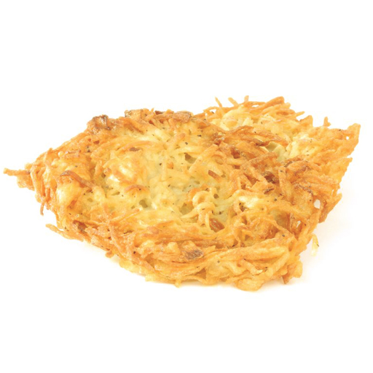
Hashbrowns and Hash Codes
How do you make hashbrowns?
Chopping a potato into nice predictable segments? No way!
Similarly, adding up the characters is not nearly “random” enough.
Can think of multiplying data by powers of some base as ensuring that all the data gets scrambled together into a seemingly random integer.
Notes:
https://cookingplanit.com/public/uploads/inventory/hashbrown_1366322674.jpg

Slide 83
Example hashCode Function
The Java 8 hash code for strings. Two major differences from our hash codes:
Represents strings as a base 31 number.
Why such a small base? Real hash codes don’t care about uniqueness.
Stores (caches) calculated hash code so future hashCode calls are faster.
@Override
public int hashCode() {
int h = cachedHashValue;
if (h == 0 && this.length() > 0) {
for (int i = 0; i < this.length(); i++) {
h = 31 * h + this.charAt(i);
}
cachedHashValue = h;
}
return h;
}

Slide 84
Example: Choosing a Base
Java’s hashCode() function for Strings:
h(s) = s₀ × 31^{n-1} + s₁ × 31^{n-2} + … + s_{n-1}
Our asciiToInt function for Strings:
h(s) = s₀ × 126^{n-1} + s₁ × 126^{n-2} + … + s_{n-1}
Which is better?
Might seem like 126 is better. Ignoring overflow, this ensures a unique numerical representation for all ASCII strings.
… but overflow is a particularly bad problem for base 126!

Slide 85
Example: Base 126
Major collision problem:
“geocronite is the best thing on the earth.”.hashCode() yields 634199182.
“flan is the best thing on the earth.”.hashCode() yields 634199182.
“treachery is the best thing on the earth.”.hashCode() yields 634199182.
“Brazil is the best thing on the earth.”.hashCode() yields 634199182.
Any string that ends in the same last 32 characters has the same hash code.
Why? Because of overflow.
Basic issue is that 126^32 = 126^33 = 126^34 = ... 0.
Thus upper characters are all multiplied by zero.
See CS61C for more.

Slide 86
Typical Base
A typical hash code base is a small prime.
Why prime?
Never even: Avoids the overflow issue on previous slide.
Lower chance of resulting hashCode having a bad relationship with the number of buckets: See study guide problems and hw3.
Why small?
Lower cost to compute.
A full treatment of good hash codes is well beyond the scope of our class.

Slide 87
Hashbrowns and Hash Codes
How do you make hashbrowns?
Chopping a potato into nice predictable segments? No way!
Using a prime base yields better “randomness” than using something like base 126.
Notes:
https://cookingplanit.com/public/uploads/inventory/hashbrown_1366322674.jpg

Slide 88
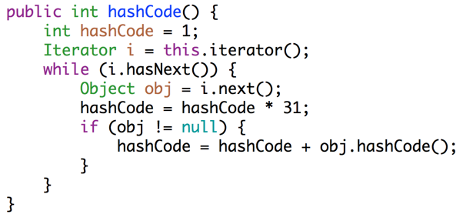
Example: Hashing a Collection
Lists are a lot like strings: Collection of items each with its own hashCode:
To save time hashing: Look at only first few items.
Higher chance of collisions but things will still work.
@Override
public int hashCode() {
int hashCode = 1;
for (Object o : this) {
hashCode = hashCode * 31;
hashCode = hashCode + o.hashCode();
}
return hashCode;
}
elevate/smear the current hash code
add new item’s hash code

Slide 89
Example: Hashing a Recursive Data Structure
Computation of the hashCode of a recursive data structure involves recursive computation.
For example, binary tree hashCode (assuming sentinel leaves):
@Override
public int hashCode() {
if (this.value == null) {
return 0;
}
return this.value.hashCode() +
31 * this.left.hashCode() +
31 * 31 * this.right.hashCode();
}

Slide 90
Summary

Slide 91
Hash Tables in Java
Hash tables:
Data is converted into a hash code.
The hash code is then reduced to a valid index.
Data is then stored in a bucket corresponding to that index.
Resize when load factor N/M exceeds some constant.
If items are spread out nicely, you get Θ(1) average runtime.
 | contains(x) | add(x)
Bushy BSTs | Θ(log N) | Θ(log N)
Separate Chaining Hash Table With No Resizing | Θ(N) | Θ(N)
… With Resizing | Θ(1)† | Θ(1)*†
data
hash function
hash code
đậu hũ
hashCode()
-2108180664
Math.floorMod(x, 4)
0
reduce
index
*: Indicates “on average”.
†: Assuming items are evenly spread.

Slide 92
Collision Resolution With Linear Probing (Extra)

Slide 93
Open Addressing: An Alternate Disambiguation Strategy (Extra)
An alternate way to handle collisions is to use “open addressing”.
If target bucket is already occupied, use a different bucket, e.g.
Linear probing: Use next address, and if already occupied, just keep scanning one by one.
Demo: http://goo.gl/o5EDvb
Quadratic probing: Use next address, and if already occupied, try looking 4 ahead, then 9 ahead, then 16 ahead, …
Many more possibilities. See the optional reading for today (or CS170) for a more detailed look.
In 61B, we’ll settle for separate chaining.

Slide 94
Citations
http://www.nydailynews.com/news/national/couple-calls-911-forgotten-mcdonalds-hash-browns-article-1.1543096
http://en.wikipedia.org/wiki/Pigeonhole_principle#mediaviewer/File:TooManyPigeons.jpg
https://cookingplanit.com/public/uploads/inventory/hashbrown_1366322674.jpg

Slide 96
What is the distinction between hash set, hash map, and hash table?
A hash set is an implementation of the Set ADT using the “hash table” as its engine.
A hash map is an implementation of the Map ADT using the “hash table” as its engine.
A “hash table” is a way of storing information, where you have M buckets that store N items. Each item has a “hashCode” that tells you which of M buckets to put that item in.

